Slide 1
Session 8
Technological drivers of Cloud

Slide 2
Objectives
SOA
Virtualization
Multicore, memory storage technology
Web 2.0 and 3.0
Pervasive computing

Slide 3
Service-oriented architecture(SOA)
SOA enables mutual data exchange between programs of different vendors without the need for additional programming or changes to the services.
A service need not have prior knowledge of the calling application, and the application does not need to have knowledge about how the tasks are performed by a service

Slide 4
Benefits of SOA
Reuse of services: Various services can be reused by different applications on different platforms
Agility: SOA can bring the architectural agility in an enterprise through the wide use of standards such as web services.
Monitoring: It helps to monitor the performance of various services to make the required changes.
Extended reach: In the collaboration between enterprises or in the case of shared processes

Slide 5
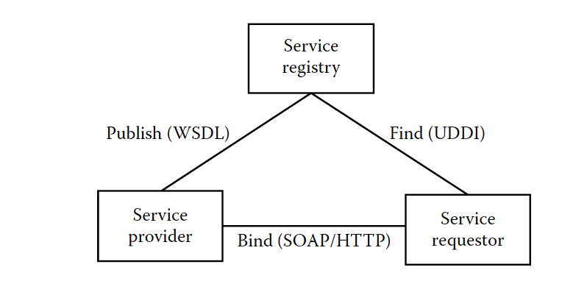
Services architectural model of SOA
Notes:
Lecturers just explains briefly the related components in SOA

Slide 6
Virtualization
Virtualization is a technology that enables the single physical infrastructure to function as a multiple logical infrastructure or resources
Virtualization is not only limited to the hardware, it can take many forms such as memory, processor, I/O, network, OS, data, and application
It helps to improve scalability and resource utilization of the underlying infrastructure.
It also enables the IT personnel to perform the administration task easier

Slide 7
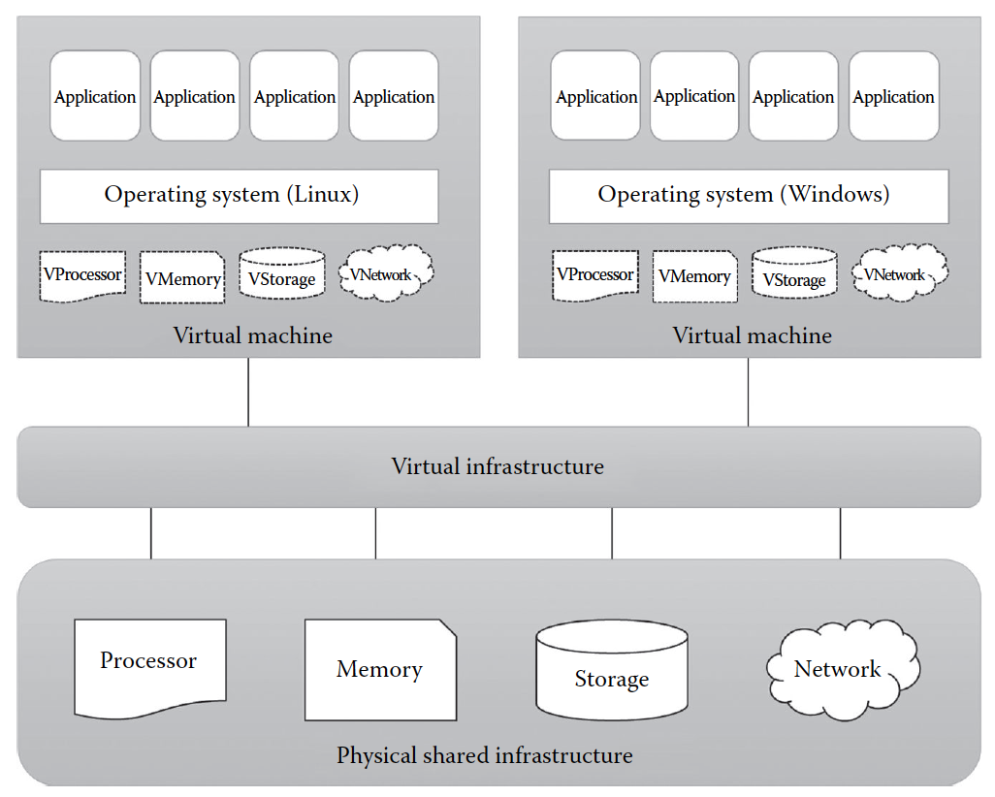
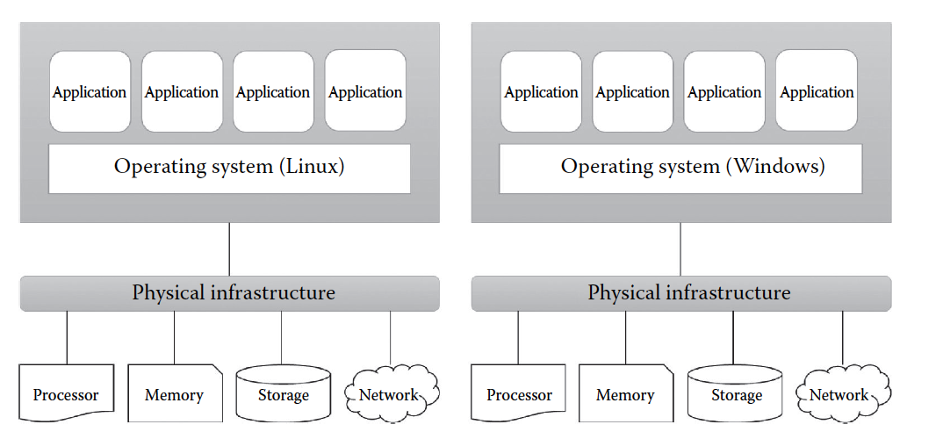
OSs and applications before and after virtualization
After
Before

Slide 8
Benefits of Virtualization
Better resource utilization
Increases ROI
Dynamic data center
Supports green IT
Eases administration
Improves disaster recovery

Slide 9
Drawback of Virtualization
Single point of failure
Demands high-end and powerful infrastructure
May lead to lower performance
Requires specialized skill set

Slide 10
Virtualization Opportunities
The different resources like memory, processors, storage, and network can be virtualized using proper virtualization technologies.

Slide 11
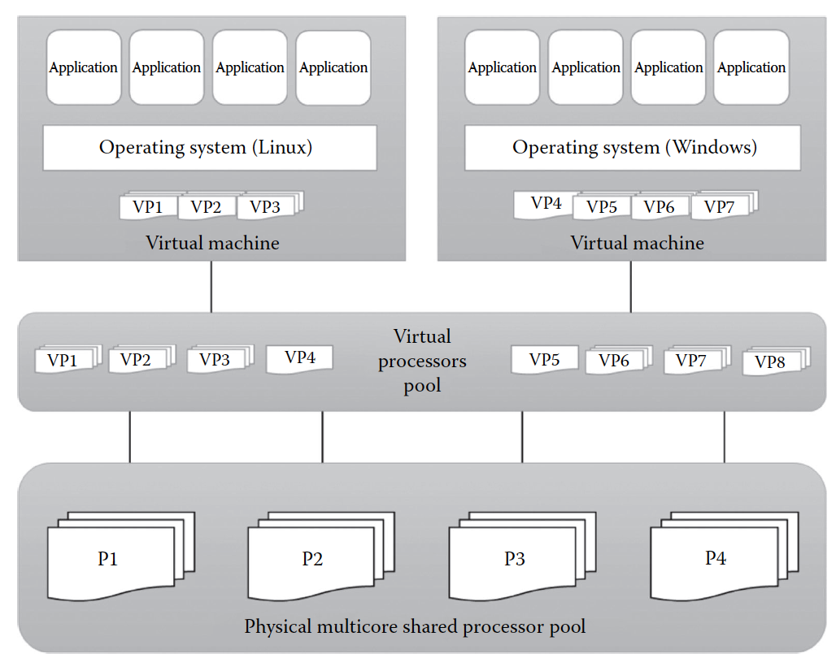
Processor virtualization

Slide 12
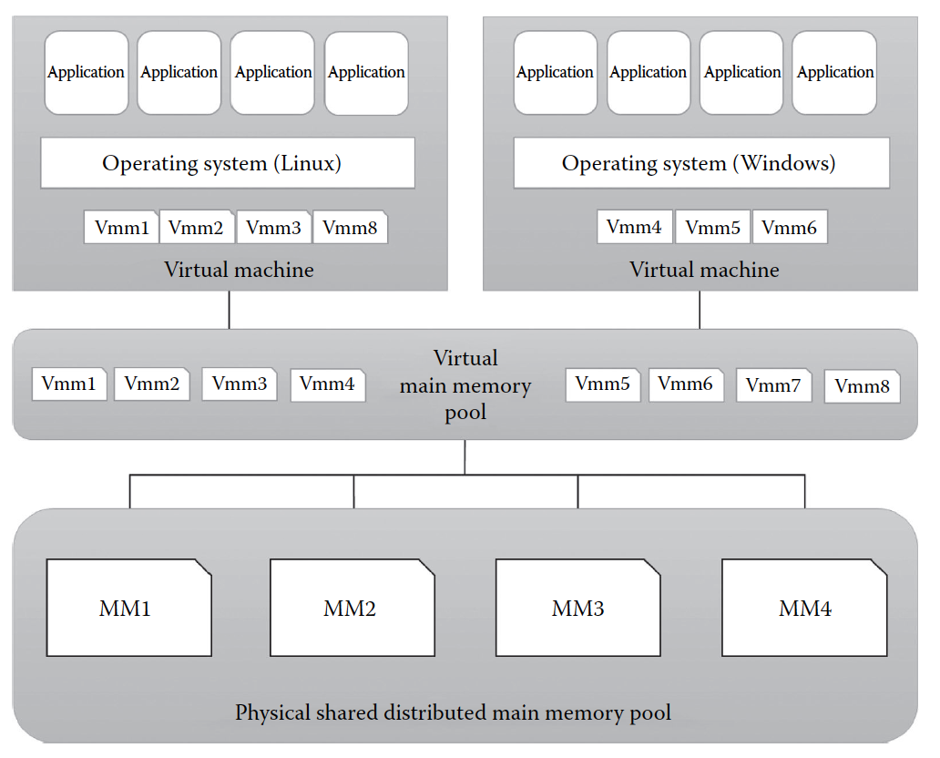
Memory Virtualization

Slide 13
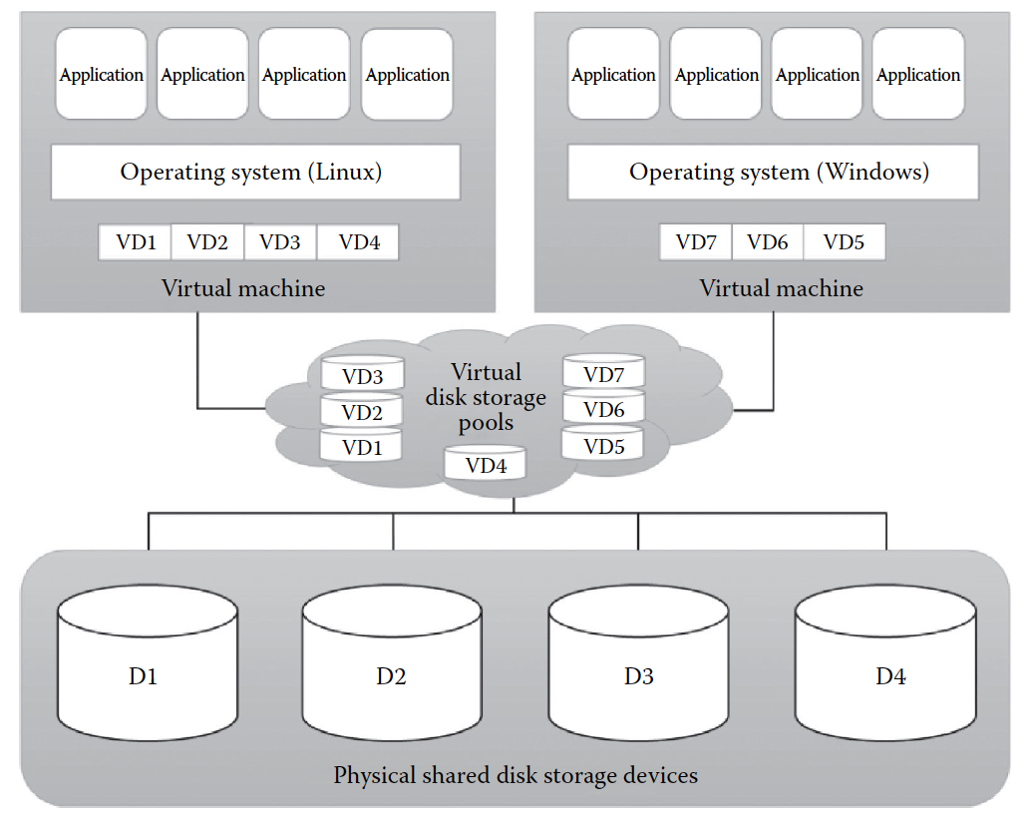
Storage virtualization

Slide 14
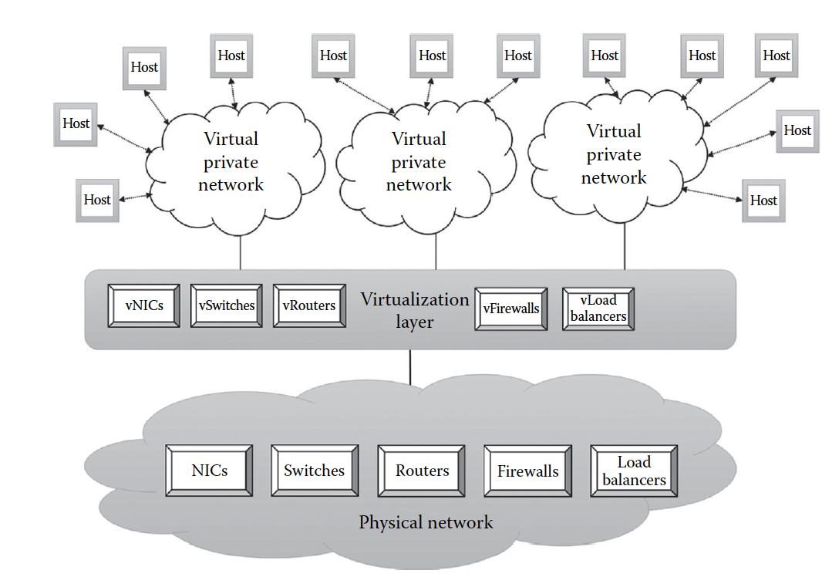
Network virtualization

Slide 15
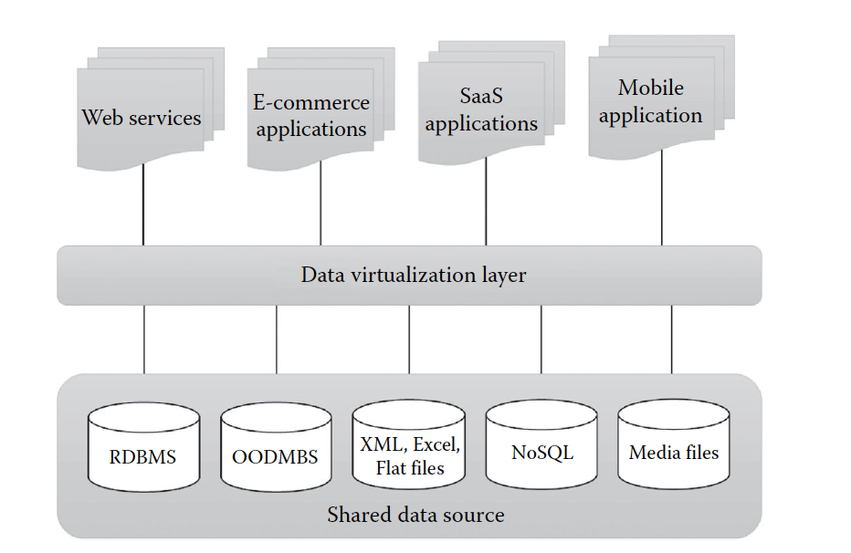
Data virtualization

Slide 16
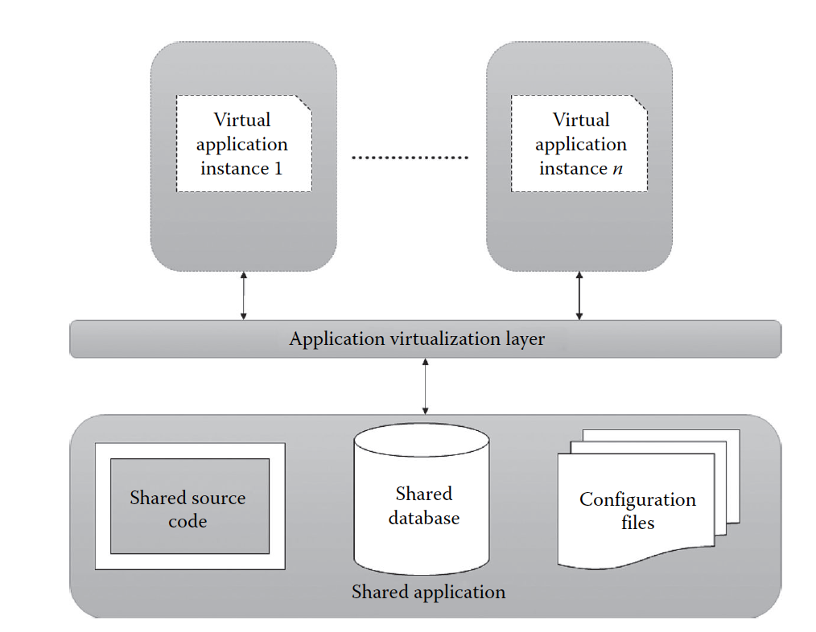
Application virtualization

Slide 17
Multicore Technology
In multicore technology, two or more CPUs are working together on the same chip.
These processors are packaged into a single integrated circuit (IC). These single ICs are called a die
Multicore technology can also refer to multiple dies packaged together
It also helps in reducing the power consumption and achieving more efficient, simultaneous processing of multiple tasks.
Multicore architecture has become the recent trend of high-performance processors

Slide 18
Memory and Storage Technologies
The cloud storage has to deal with various kinds of data such as medical images, MP3, photos, 3D high-definition imaging, video streaming, surveillance camera captures, and film animations

Slide 19
Cloud Storage Requirements
Scalability
High availability
High bandwidth
Constant performance
Load balancing

Slide 20
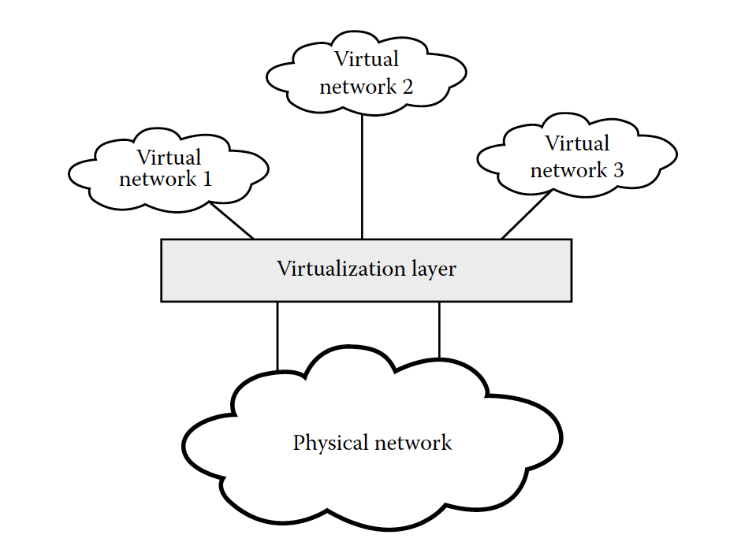
Network Requirements for Cloud
Consolidate workloads and provide Infrastructure as a Service (IaaS) to various tenants
Provide VM connectivity to physical and virtual networks
Ensure connectivity and manage network bandwidth
Speed application and server performance

Slide 21
Web 2.0
Is the popular term given to the advanced Internet technology and applications that include blogs, wikis, really simple syndication (RSS), and social bookmarking
Web 2.0 facilitates greater collaboration and information sharing among Internet users, content providers, and enterprises. Hence, in that sense, this can be considered as a migration from the read-only web to a read/write web

Slide 22
Web 2.0 examples
BookFinder4U allow the users to upload book reviews to the site and also help the users find rare and out-of-print books at a reasonable price
Wikipedia permit users not only to read the stored information but also to create and edit the contents of the information database in multiple languages

Slide 23
Web 3.0
It refers to the third generation of Internet-based services that is collectively called the intelligent web
Includes services on the Internet that use technologies such as semantic web, natural language search, machine learning, recommendation agents, and artificial intelligence to achieve machine-facilitated understanding of information in order to provide a more productive and intuitive experience to the web users

Slide 24
Web 3.0 examples
The Facebook Open Graph is a great example for the scalability feature offered by Web 3.0
The Like button provided by Facebook could be considered as a simple manifestation of all these because a single click can offer the analysts an invaluable amount of information that could later be used for further communication with friends and also to make recommendations and discoveries.
Search Optimization and Web Commerce: Best Buy

Slide 25
Programming Models in Cloud
There are different programming models that are used for solving various compute- or data-intensive problems in cloud
The model to be selected depends on the nature of the problem and also on the QoS expected from the cloud environment

Slide 26
Programming models example
Bulk synchronous parallel (BSP) model has been widely applied in parallel databases, search engines, and scientific computing
MapReduce Model is able to support convenient access to the large-scale data for performing computations while hiding all low-level details of physical environments
SAGA is a high-level programming interface that provides the ability to create distributed applications in an infrastructure-independent way
Transformer: various models such as MapReduce , Dryad, and All-Pairs can be built
Grid Batch Framework: an alternative to parallel computational models

Slide 27
Pervasive Computing
Is a combination of technologies, such as Internet capabilities, voice recognition, networking, artificial intelligence, and wireless computing, used to make computing anywhere possible
Pervasive computing is also called ubiquitous computing
The words pervasive and ubiquitous mean existing everywhere

Slide 28
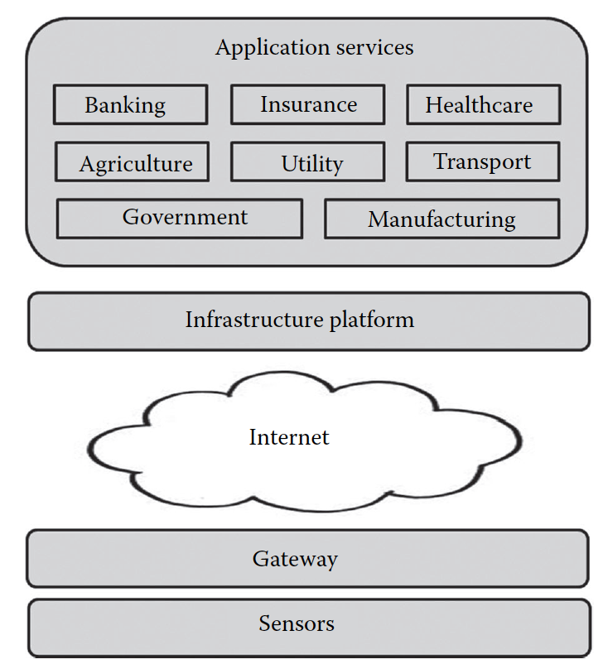
Pervasive computing stack

Slide 29
Summary
SOA
Virtualization
Multicore, memory storage technology
Web 2.0 and 3.0
Pervasive computing
More: https://www.ibm.com/cloud/learn/virtualization-a-complete-guide

